Slide 1
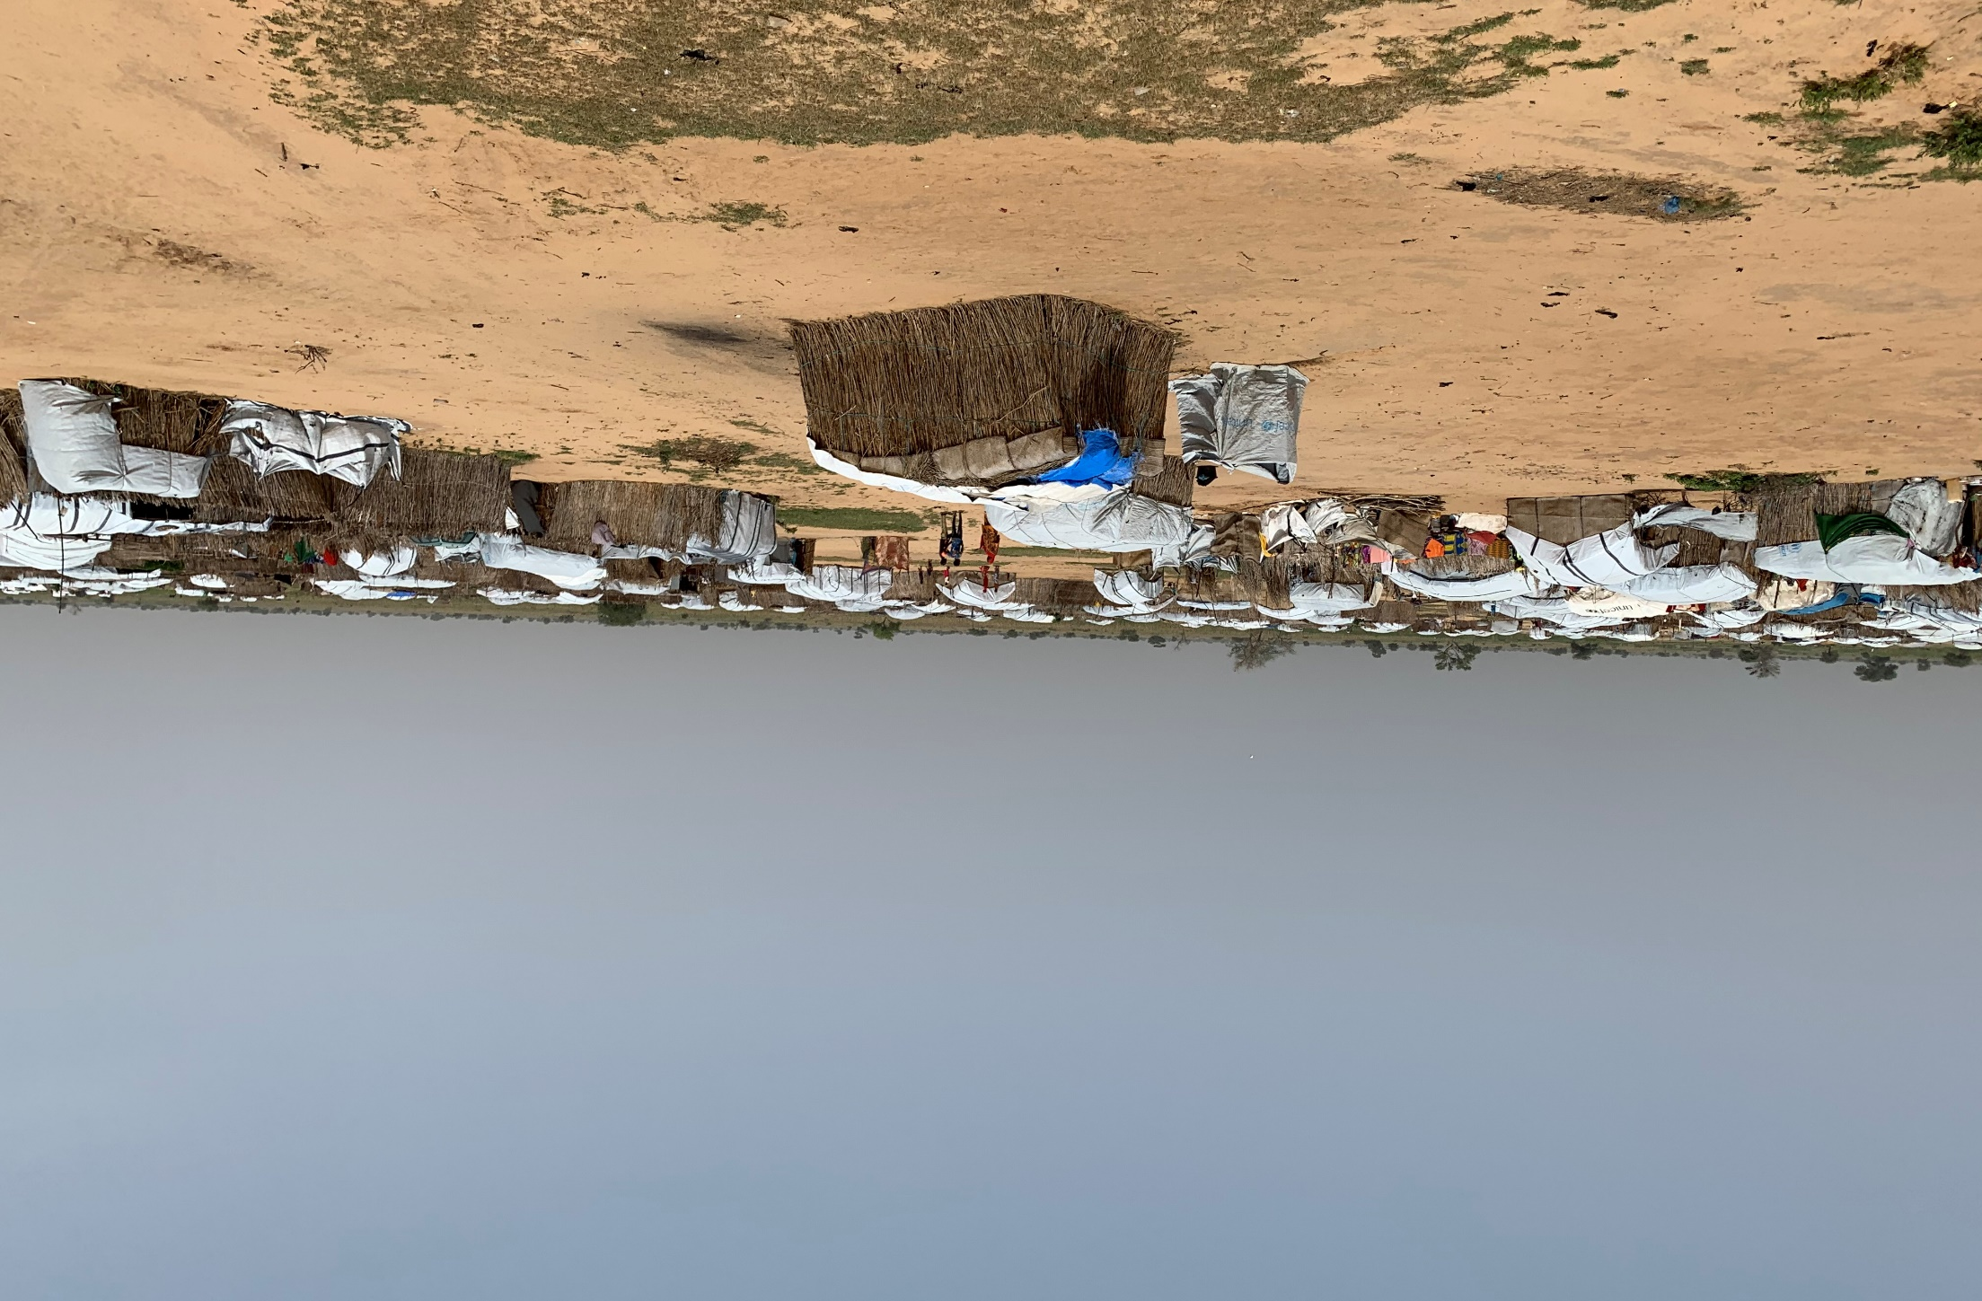


Comparative studies of the environmental impact of emergency shelter models in the Sahel Region

Slide 2
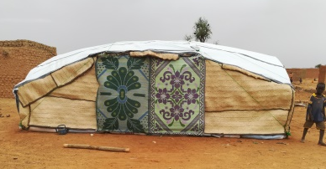

Purpose
Aim: to reduce the environmental impact of the shelter programs implemented in the Sahel (Burkina Faso, Chad, Niger & Mali) by International Aid of the Luxembourg Red Cross.
A contribution to the growing body of work on the environmental impact of humanitarian assistance.

Slide 3





Methodology
Criteria used to analyse environmental impact

Slide 4

Methodology
A score card highlights in a simple way what the main environmental issues are for each shelter, thus identifying where mitigating solutions could help to reduce the overall environmental impact of the shelter models.
Score Card Approach

Slide 5

Conclusions
Comparing different shelter models requires balancing relative sources of environmental harm across the four different criteria.
This study is one of the first to use the SMAC, the new carbon footprint calculation tool for the shelter sector.
The benefit of using the score card approach is to highlight how different shelters perform against the different criteria, to allow more explicit inclusion of local factors and to easily identify mitigation solutions.
Between the different options, the ‘least harmful solution’ should be adopted.

Slide 6

Conclusions
The final verdict for each shelter rests on the feasibility of the options available to mitigate some of the environmental impacts.
While the need to reduce carbon emissions is critical and well acknowledged today, it is clear is that waste is one of the hidden problems of humanitarian response.
Use of local natural materials, including their disposal, also needs to be carefully analysed.
The published reports, (English and French), are available on the Global Shelter Cluster web site
Notes:
The final verdict for each shelter rests on the feasibility of the options available to mitigate some of the environmental impacts. if adopted in the future, could reduce the overall environmental impact of shelters.
While the need to reduce carbon emissions is critical and well acknowledged today, it is clear is that waste is one of the hidden problems of humanitarian response. . It is usually ignored during project design, and rarely discussed at more strategic levels.
Use of local natural materials, including their disposal, also needs to be carefully analysed.
The published reports, (English and French), are available on the Global Shelter Cluster web site

Slide 7


